Slide 1

Lecture 1: AI for Railway Transportation
Promises, limitations and challenges
Dr. Andrea Staino
School of Engineering, Trinity College Dublin
Alstom Digital and Integrated Systems
Lecture 1: AI for Railway Transportation
Computation for Transportation Engineering – Hilary Term 2024

Slide 2

Agenda
AI and Machine Learning: an overview
AI and Machine Learning for Railway Maintenance
Predictive Maintenance of Air Conditioning Subsystem
Monitoring of compressor performance: test bench and train results
Limitations, challenges and promises
Lecture 1: AI for Railway Transportation
Computation for Transportation Engineering – Hilary Term 2024

Slide 3
Today’s plan
See some fundamental notions about ML and the type of issues to face
Familiarize with Python’s pandas / plotly
Start to look at applications in railways
Understand the limits of AI/ML in general and for transportation systems
Course Intro
Computation for Transportation Engineering – Hilary Term 2024

Slide 4
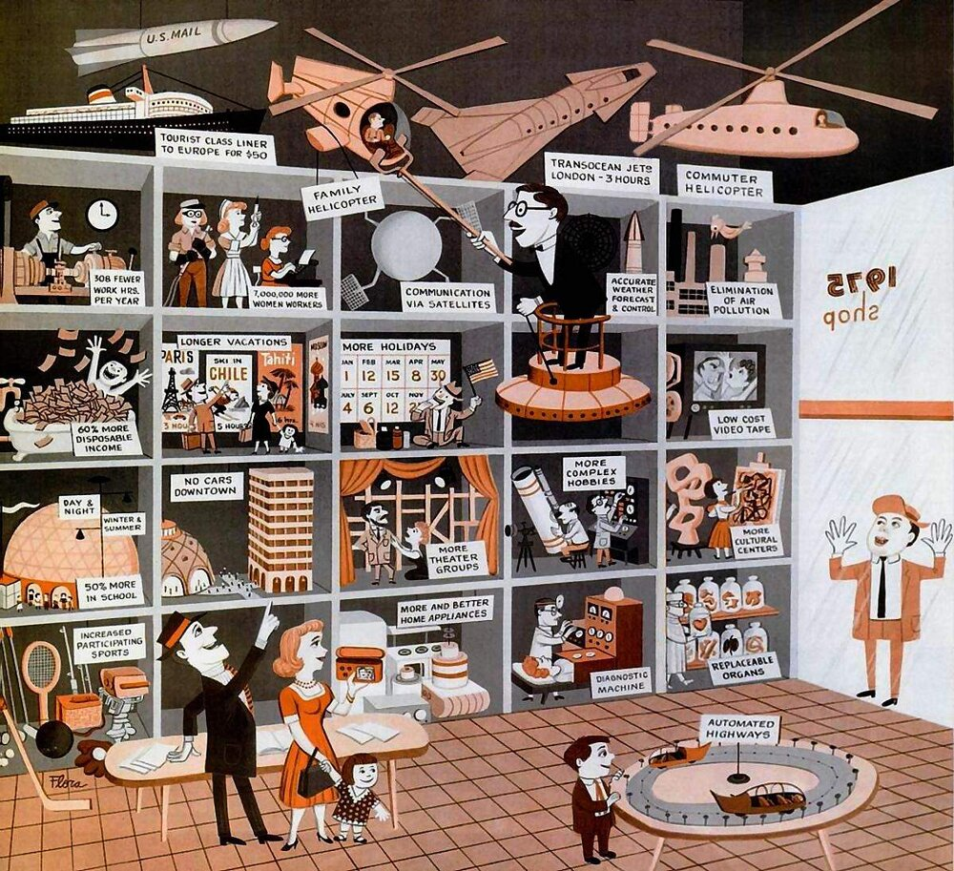
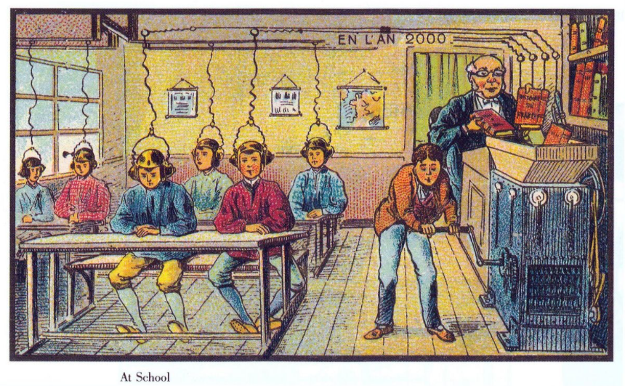
The AI myth at its origins
Lecture 1: AI for Railway Transportation
Computation for Transportation Engineering – Hilary Term 2024

Slide 5
AI and Machine Learning – A Brief History
First use of the term AI: 1956 (John McCarthy)
AI: mimic human cognitive functions – very general.
ML: techniques that enable machines to improve at tasks through experience.
NN: computing systems made of simple processing nodes that are densely interconnected.
DL: technique based on multi-layered neural networks to learn with minimal human intervention
ARTIFICIAL INTELLIGENCE
MACHINE LEARNING
Symbolic AI
RF
NEURAL NETWORKS
Decision Trees
Bayesian methods
“Shallow” ANNs
DEEP LEARNING
CNN RNN
AE
…..
SVM
Lecture 1: AI for Railway Transportation
Computation for Transportation Engineering – Hilary Term 2024

Slide 6
AI and Machine Learning – A Brief History
“In from 3 to 8 years, we will have a machine with the general intelligence of an average human being.” M. Minsky, 1970
Cats recognition from youtube videos 2012
XOR limitation,
Papert and Minsky, 1969
interest In AI
Brooks, Elephants don’t play chess, 1990
AlphaGO, 2016
First AI winter
Boom
Second AI Winter
Rebirth
Deep Learning
Golden Years
1956
1974
1980
1987
1993
2011
Lighthill report, 1973
Killer car, 2017
Dartmouth summer research project on Artificial Intelligence
“No program today can distinguish a dog from a cat, or recognize objects in typical rooms, or answer questions that 4-year-olds can!”, M. Minsky, 2001
Lecture 1: AI for Railway Transportation
Computation for Transportation Engineering – Hilary Term 2024

Slide 7
Machine Learning – definition attempts
“Field of study that gives computers the ability to learn without being explicitly programmed (Samuel, 1959).
Instead of coding rules (model) into the machine, provide the machine with many observations and train it to learn by examples (see Tom Mitchell, 1998).
Traditional approach: the user defines the model and provides the input to get the output
Machine Learning approach: learning of the model from data using statistical methods
Input
Output
Model
MACHINE
Input
Model
Output
MACHINE
Lecture 1: AI for Railway Transportation
Computation for Transportation Engineering – Hilary Term 2024

Slide 8
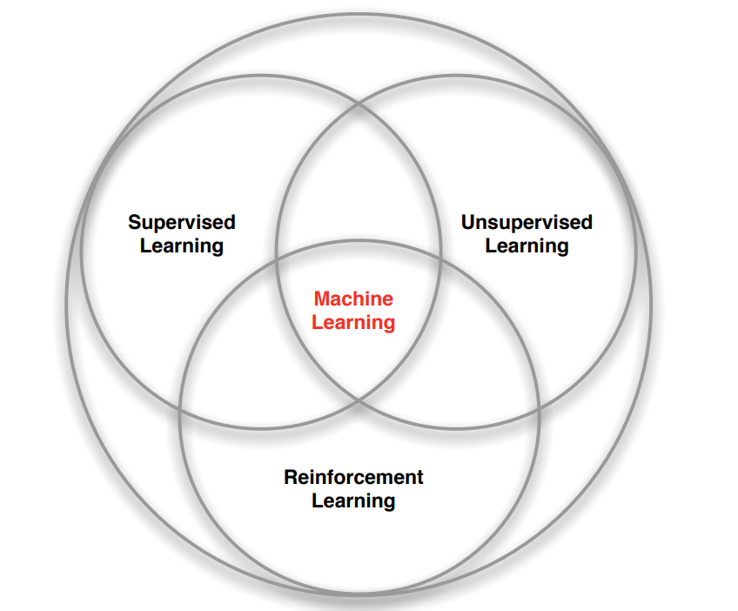

Branches of Machine Learning
Given the data and the corresponding labels, predict the output
Learn patterns and draw inference from untagged data
Learn a policy of taking actions in a dynamic environment and obtain immediate rewards
Image from David Silver’s lecture on Reinforcement Learning
Lecture 1: AI for Railway Transportation
Computation for Transportation Engineering – Hilary Term 2024

Slide 9
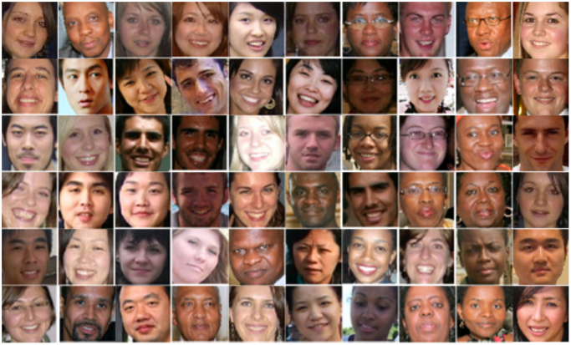
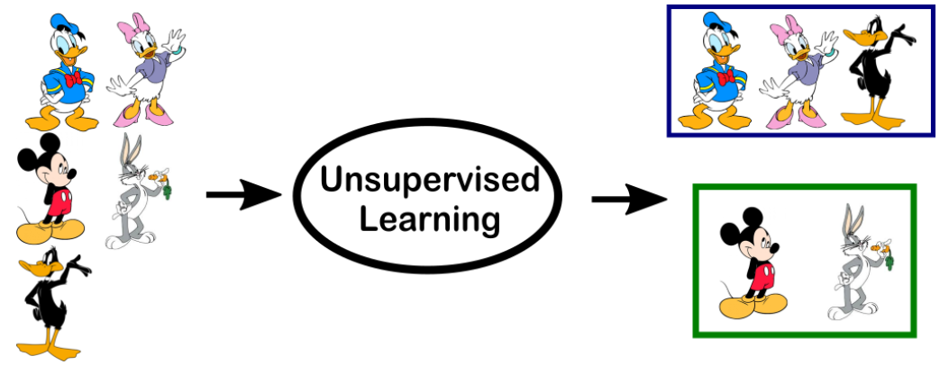
Supervised and Unsupervised Learning
Supervised learning: the algorithm learns on a labeled dataset.
The algorithm is first trained on labeled input data ( the «training set »), then, it is evaluated on the test set
Example: face gender classification
Unsupervised learning: the algorithms learns patterns and structures from unlabeled data.
The algorithms attempts at inferring a function to describe hidden structure from “unlabeled” data
Example: Clustering
Lecture 1: AI for Railway Transportation
Computation for Transportation Engineering – Hilary Term 2024

Slide 10
Sample uses of Machine Learning
SUPERVISED LEARNING
UNSUPERVISED LEARNING
CLASSIFICATION | CLUSTERING
REGRESSION | DIMENSIONALITY REDUCTION
DISCRETE DATA
CONTINOUS DATA
Lecture 1: AI for Railway Transportation
Computation for Transportation Engineering – Hilary Term 2024

Slide 11
Classification
Goal: predict the class of given data points (e.g. male/female in image recognition; healthy or degraded asset in railway maintenance)
Data are divided in two (binary classification) or more classes (multi-class classification)
Different techniques can be used:
Decision Trees
K-Nearest Neighbors
Support Vector Machines
Logistic Regression
Artificial Neural Networks
Random Forest
Stochastic Gradient Descent
Naïve Bayes classifier
…
The label is a discrete variable
Lecture 1: AI for Railway Transportation
Computation for Transportation Engineering – Hilary Term 2024

Slide 12

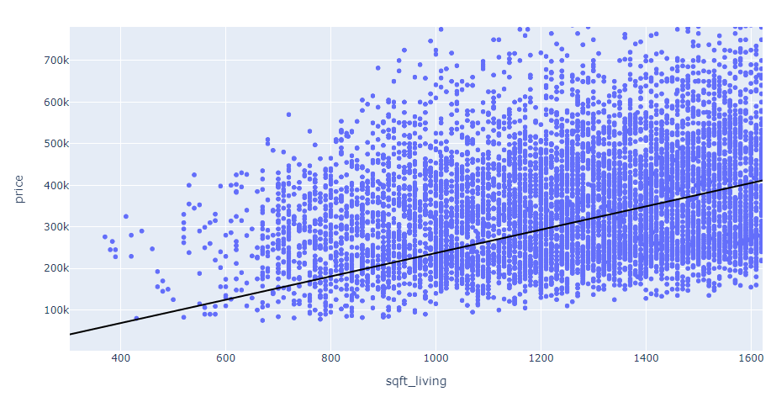
Regression
Goal: predict a continuous variable of interest
Example: predict the price of house
Given: a dataset that contains n samples: (x₁, y₁), (x₂, y₂), ….(x_{n}, y_{n})
Task: If a house has x_{s} sq. ft., predict its price y_{s}
y_{s} = M x_{s} + c → Linear Regression
Supervised learning process: solving for M and c, given (x₁, y₁), (x₂, y₂), ….(x_{n}, y_{n})
x’s: input samples (surface), y’s: labels (price)
coefficient
Input data
bias
predicted output
x: input/feature
y: label
Lecture 1: AI for Railway Transportation
Computation for Transportation Engineering – Hilary Term 2024

Slide 13
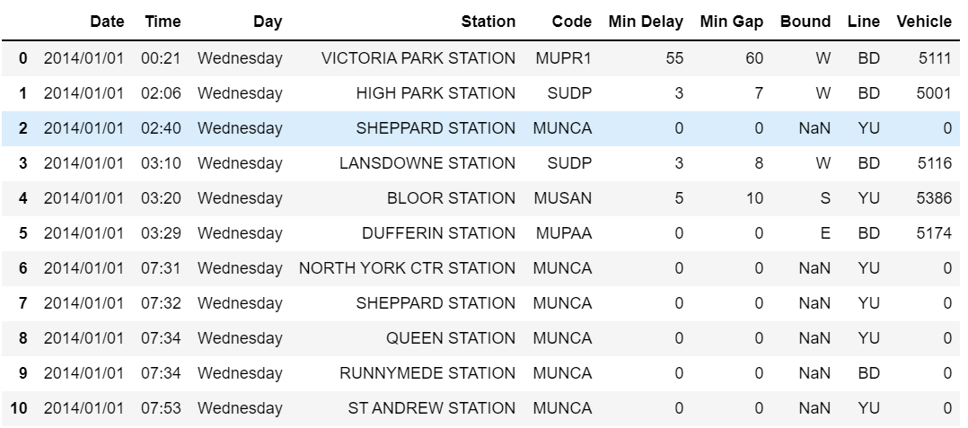
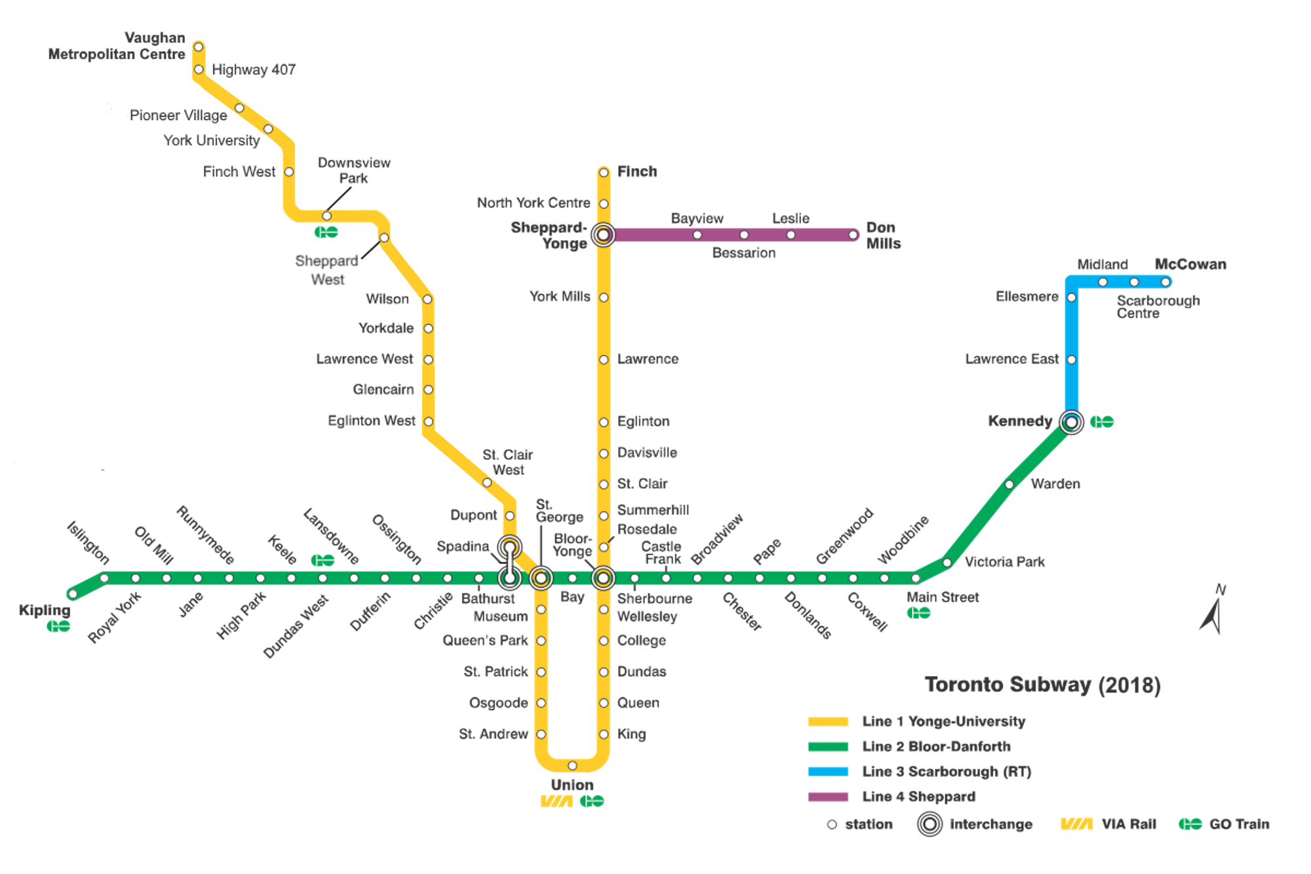
Regression assignment
Dataset: Toronto Subway Delay Data
Toronto Subway Delay and Time Length between Trains in Minutes (Jan 2014 -Jun 2021)
Question: how to express the delay at given station as a function of the gap between trains?
Programming assignment:
for a year of your choice, what is the day when the biggest delay occurred?
for a year of your choice what is the day of the week with the largest cumulated delay?
Lecture 1: AI for Railway Transportation
Computation for Transportation Engineering – Hilary Term 2024
Notes:
Classification: error code

Slide 14
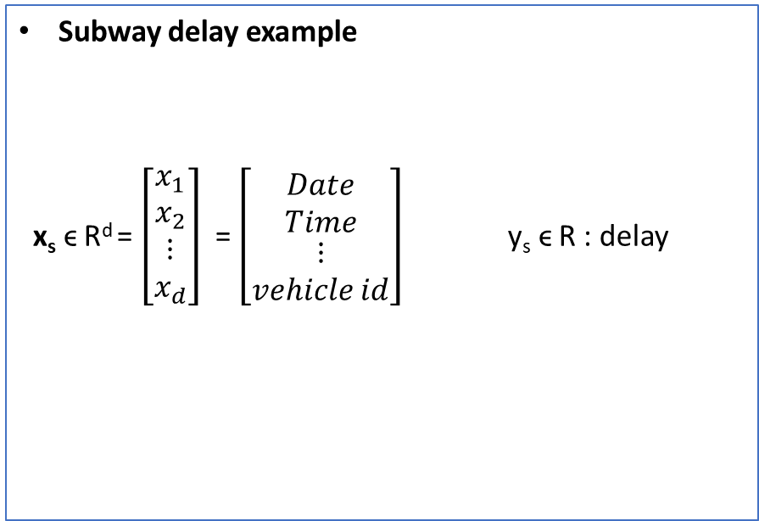
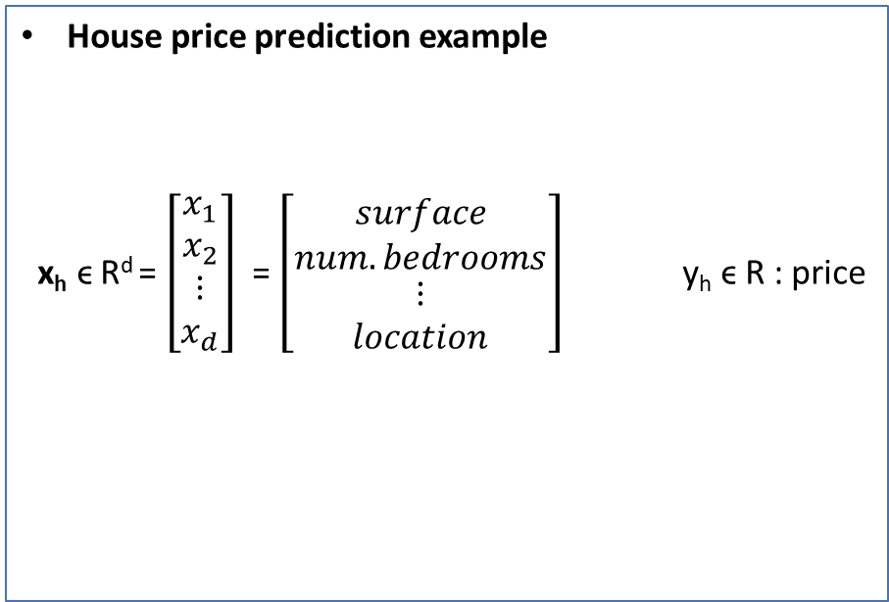
More features
House price prediction example
x_{h} ϵ R^{d} = $\left[\begin{matrix}x_{1} \\ x_{2} \\ \begin{matrix}⋮ \\ x_{d}\end{matrix}\end{matrix}\right]$ = $\left[\begin{matrix}surface \\ num. bedrooms \\ \begin{matrix}⋮ \\ location\end{matrix}\end{matrix}\right]$ y_{h} ϵ R : price
Subway delay example
x_{s} ϵ R^{d} = $\left[\begin{matrix}x_{1} \\ x_{2} \\ \begin{matrix}⋮ \\ x_{d}\end{matrix}\end{matrix}\right]$ = $\left[\begin{matrix}Date \\ Time \\ \begin{matrix}⋮ \\ vehicle id\end{matrix}\end{matrix}\right]$ y_{s} ϵ R : delay
f_{h}
f_{s}
label
Vector of features
Supervised learning process: determine the unknown function f, given a training set of labelled examples (x^{j}, y^{j})
Lecture 1: AI for Railway Transportation
Computation for Transportation Engineering – Hilary Term 2024

Slide 15
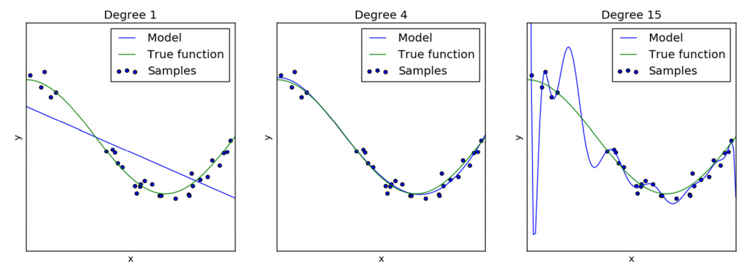
Model fitting: Underfitting and Overfitting
Lecture 1: AI for Railway Transportation
Computation for Transportation Engineering – Hilary Term 2024

Slide 16
Agenda
AI and Machine Learning: an overview
AI and Machine Learning for Railway Maintenance
Predictive Maintenance of Air Conditioning Subsystem
Monitoring of compressor performance: test bench and train results
Limitations, challenges and promises
Lecture 1: AI for Railway Transportation
Computation for Transportation Engineering – Hilary Term 2024

Slide 17
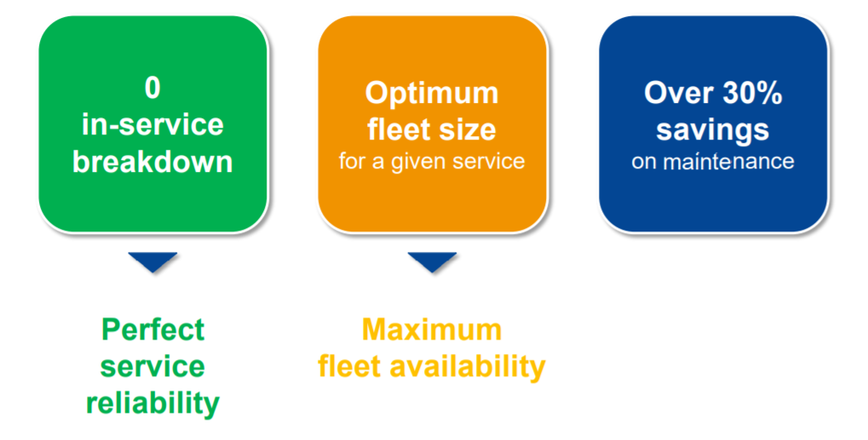
AI-enabled railway maintenance
Predictive Maintenance vision
Lecture 1: AI for Railway Transportation
Computation for Transportation Engineering – Hilary Term 2024

Slide 18
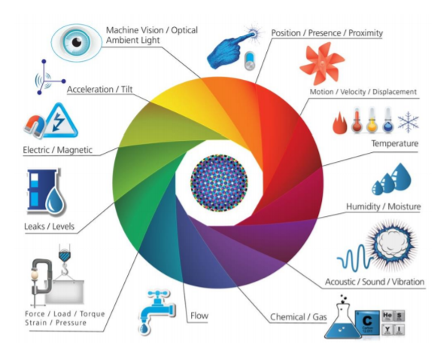
Enablers: The IoT, The Internet of Trains
Lecture 1: AI for Railway Transportation
Computation for Transportation Engineering – Hilary Term 2024

Slide 19
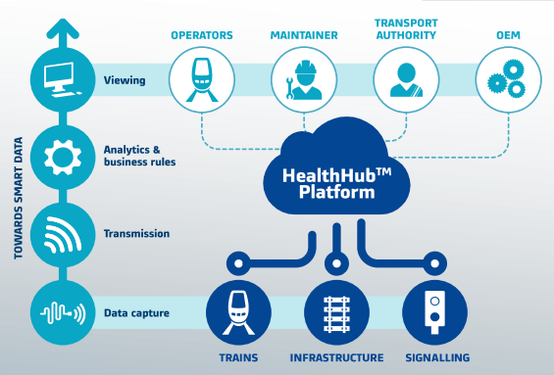
Railway Maintenance and Alstom approach
Corrective maintenance:
run to failure.
Preventive maintenance: systematically on time/mileage basis (“blindly”).
Predictive maintenance: tasks triggered by alerts generated by predictive algorithms on the basis of the actual health of the target equipment.
Lecture 1: AI for Railway Transportation
Computation for Transportation Engineering – Hilary Term 2024

Slide 20
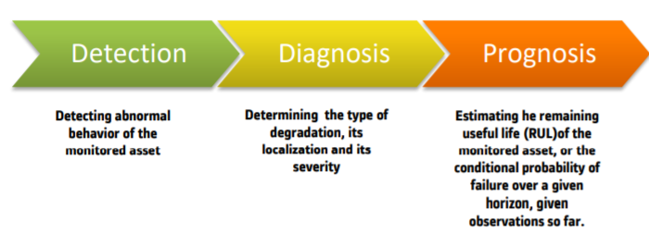
Prognostics and Health Management
A set of techniques and tools to enable predictive maintenance and to support corresponding decisions.
Three main actions:
Lecture 1: AI for Railway Transportation
Computation for Transportation Engineering – Hilary Term 2024

Slide 21
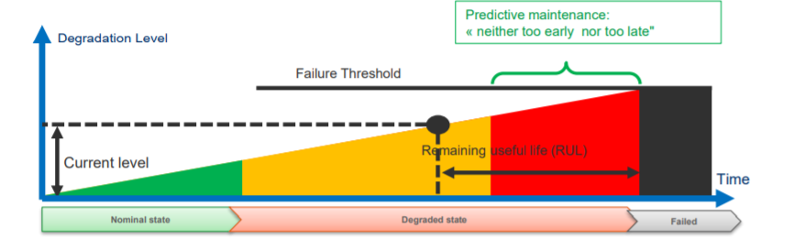
Prognostics and Health Management
Detection: a binary classification problem.
based on a set of observed signals, decide whether an asset is in a healthy or rather in a degraded state
Diagnostics: in general, a multi-class classification problem.
in case of degradation, determine the type of degradation
Prognostics: predicting the RUL
taking uncertainty into account ( models and measurements)
Lecture 1: AI for Railway Transportation
Computation for Transportation Engineering – Hilary Term 2024

Slide 22

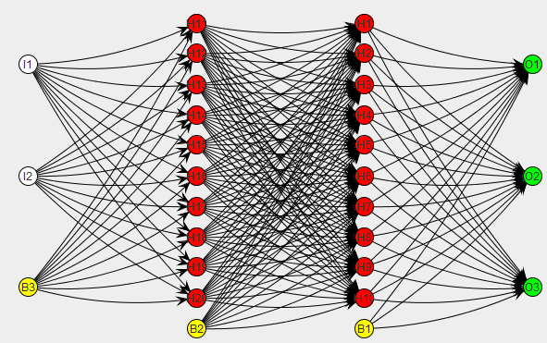
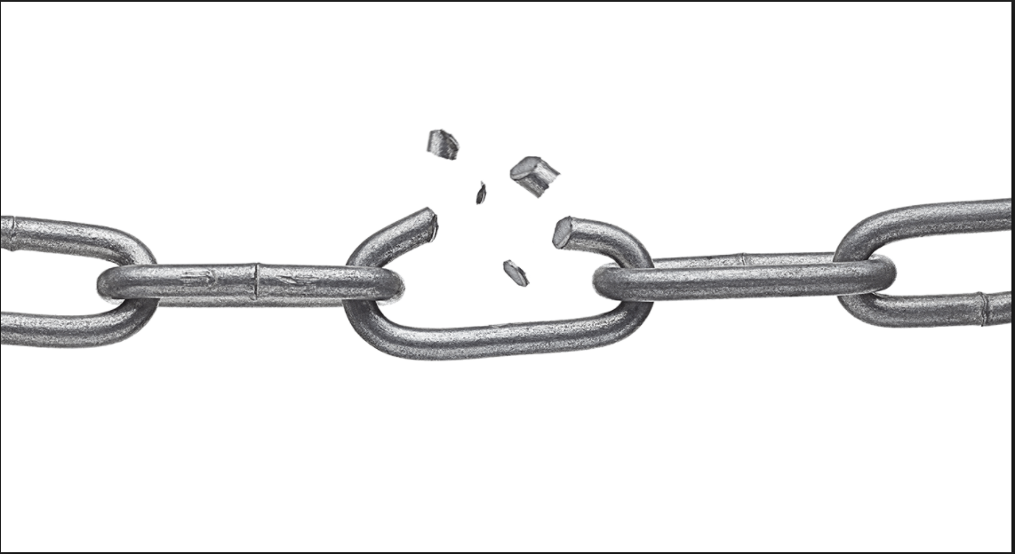
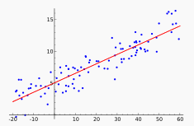
PHM models
Model (physics)-based approach
Apply “physics of failure” to estimate time to failure using fault propagation models, e.g.
Cumulative damage fatigue models
Crack growth models
Mechanical wear through contact models
Corrosion models
Clogging models
…
Data-driven approach
Learn degradation signatures and rates solely from data, e.g.
Regression models
Neural Networks (ANN, RNN)
Self Organizing Maps (SOM)
Support Vector Machines (SVM)
Bayesian methods
Markov models
…
Combinations are possible → hybrid approach!
Lecture 1: AI for Railway Transportation
Computation for Transportation Engineering – Hilary Term 2024

Slide 23



State detection – evaluation criteria
Detection theory
Confusion matrix for binary classification
Decision threshold
Healthy sample Distribution
Degraded sample Distribution
Probability density
False negative (Non detection) probability
False positive (False alarm) probability
Detection and standard deviation
 |  | Predicted condition
 | Total population | Degraded | Healthy
True condition | Degraded | True Positive (TP) | False Negative (FN)
 | Healthy | False Positive (FP) | True Negative (TN)
Objectives
Increase True Positive
Decrease False Positive
Lecture 1: AI for Railway Transportation
Computation for Transportation Engineering – Hilary Term 2024

Slide 24
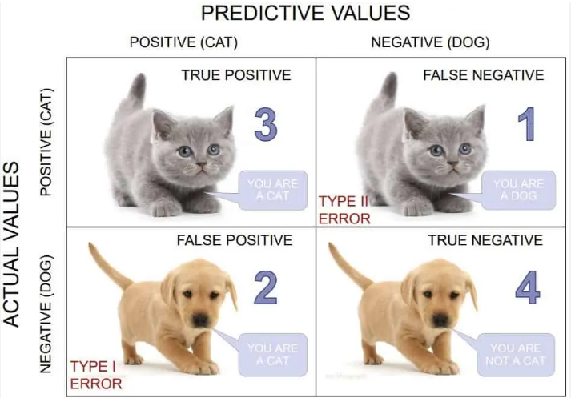
State detection – performance metrics
Different performance metrics can be derived from the confusion matrix:
Error rate:
(FP+FN)/(P+N) = (FP+FN)/(TP+FN+TN+FP)
Accuracy:
(TP+TN)/(P+N) = (TP+TN)/(TP+FN+TN+FP)
Sensitivity (aka recall or True Positive Rate – TPR):
TP/P = TP/(TP+FN)
Specificity (aka True Negative Rate – TNR):
TN/N = TN/(TN+FP)
False Positive Rate FPR:
FP/N = FP/(FP+TN) = 1 - specificity
Precision (aka positive predicted value):
TP/(TP+FP)
F-score (harmonic mean of precision and recall):
2 * (precision*recall)/(precision+recall)
Lecture 1: AI for Railway Transportation
Computation for Transportation Engineering – Hilary Term 2024

Slide 25
ROC curve
Receiver Operating Characteristic (ROC) curve:
Illustrates the performance of the classifier at various threshold settings.
TPR against FPR for different thresholds
Each prediction result of a confusion matrix represents one point in the ROC space.
1
Healthy sample Distribution
Degraded sample Distribution
Probability density
False negative
False positive
TPR
AUC
Random classifier
better
worse
The Area under the Curve (AuC) provides a quantitative indication of the performance of the classifier.
0
1
FPR
Lecture 1: AI for Railway Transportation
Computation for Transportation Engineering – Hilary Term 2024

Slide 26
Agenda
AI and Machine Learning: an overview
AI and Machine Learning for Railway Maintenance
Predictive Maintenance of Air Conditioning Subsystem
Monitoring of compressor performance: test bench and train results
Limitations, challenges and promises
Lecture 1: AI for Railway Transportation
Computation for Transportation Engineering – Hilary Term 2024

Slide 27
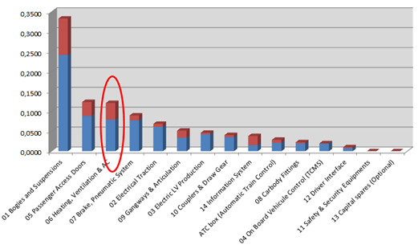





Motivation: the need for Predictive Maintenance for HVAC
Maintenance costs: significant impact on Life Cycle Cost at train level
HVAC Malfunctioning
- Passenger discomfort
- Service affecting failures
Lecture 1: AI for Railway Transportation
Computation for Transportation Engineering – Hilary Term 2024

Slide 28
Maintenance of refrigeration systems
Degraded operation of compressor may result in:
increased energy usage
reduced cooling capacity
decreased equipment lifespan
failure of the unit
Periodic “manual” checks are:
Oftentimes negative
Costly, tedious and time-consuming
Invasive and/or unreliable
Impact on reliability, availability and comfort
Impact on availability and maintenance costs
Lecture 1: AI for Railway Transportation
Computation for Transportation Engineering – Hilary Term 2024

Slide 29

Digital-twin for railway maintenance applications
Virtual Prototype
-> digital representation of a physical system
Digital twin
-> “living” virtual prototype updated on data collected from the associated physical counterpart
Maintenance application
-> analyze sensor data to model the behavior of the train under various mission profiles to predict when faults and failures could occur.
Lecture 1: AI for Railway Transportation
Computation for Transportation Engineering – Hilary Term 2024

Slide 30
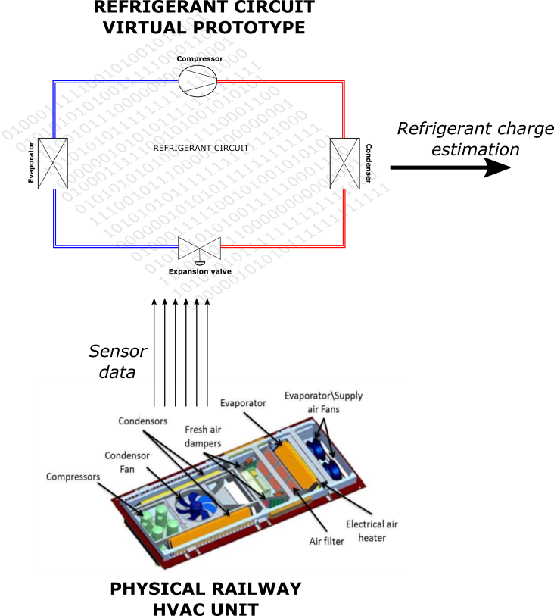
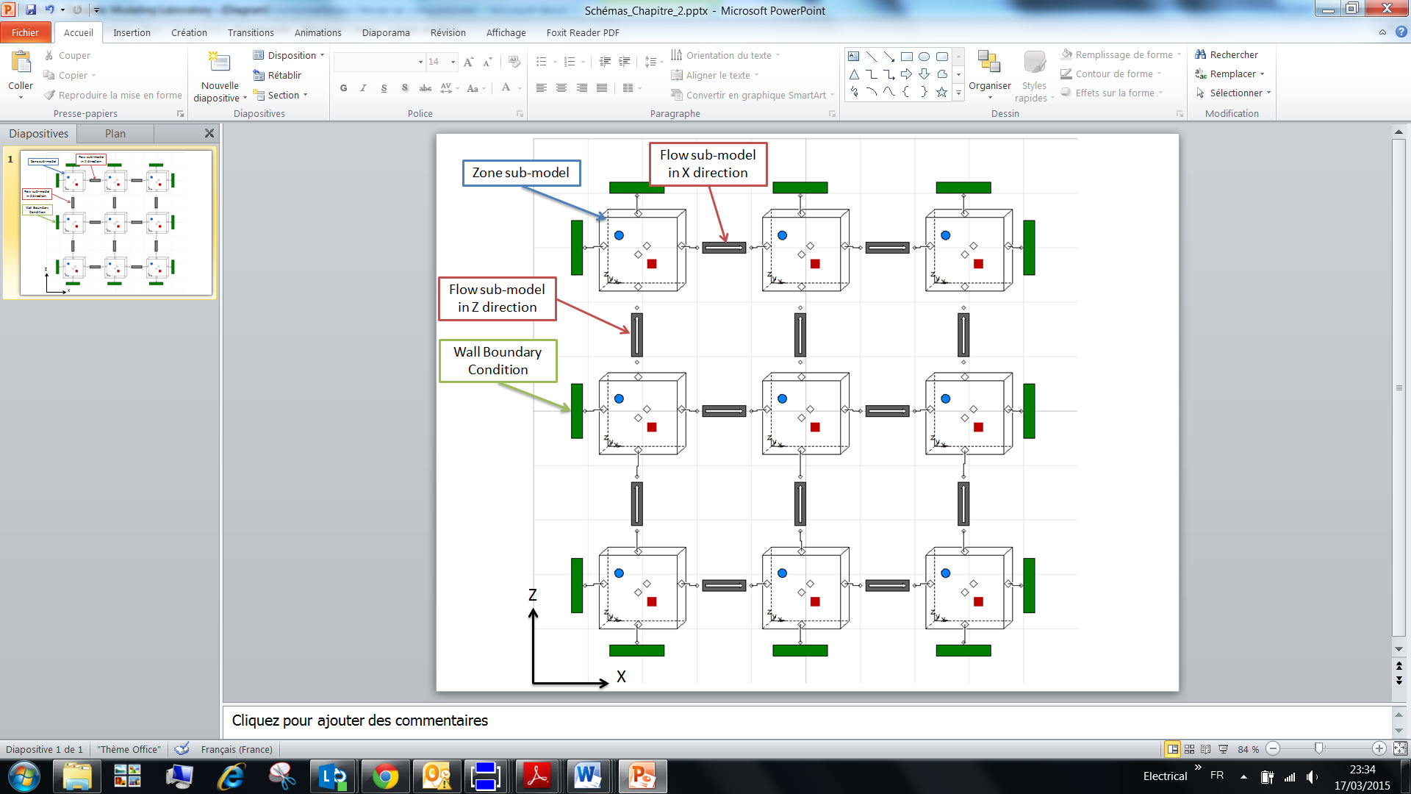
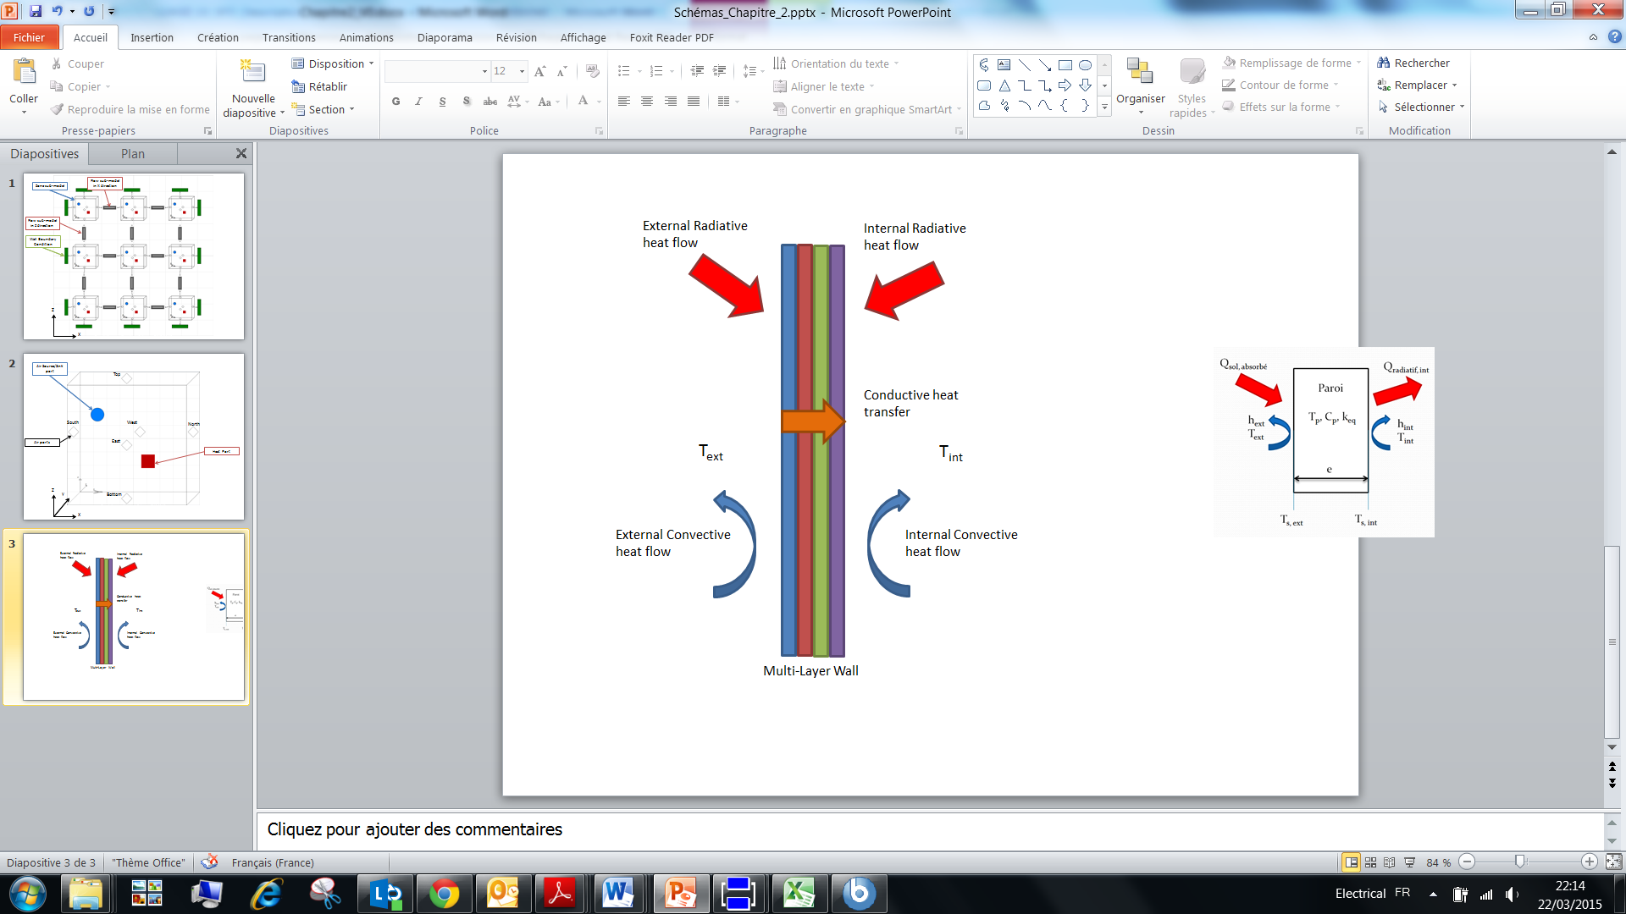
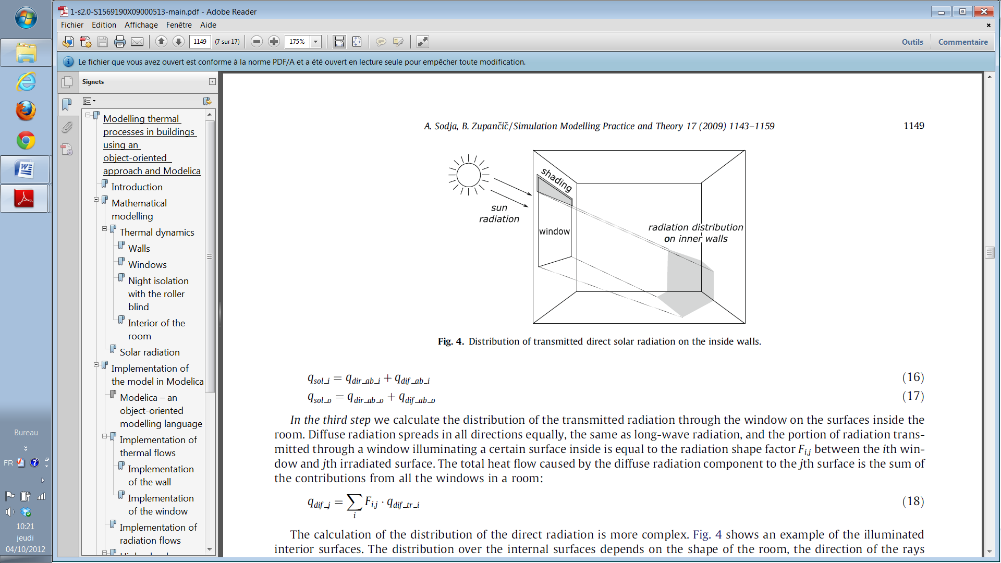
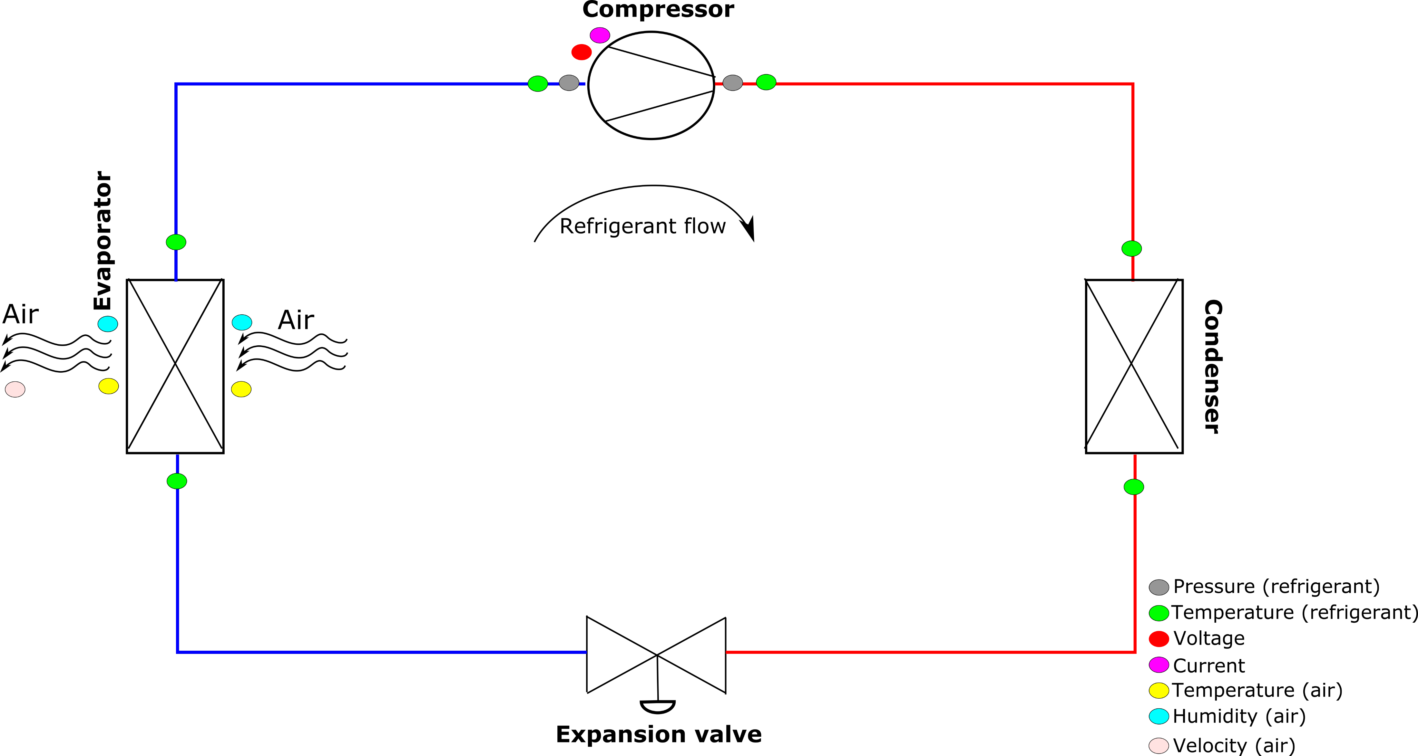
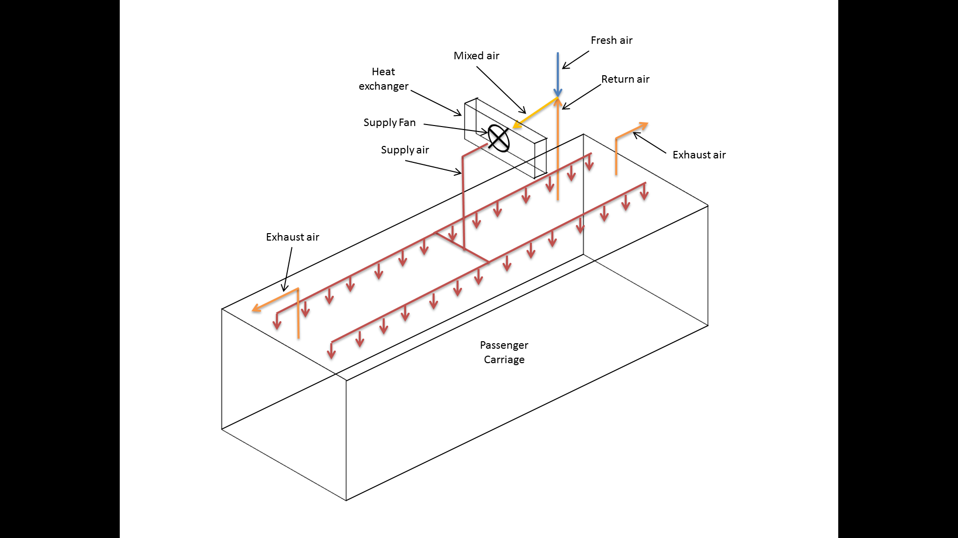
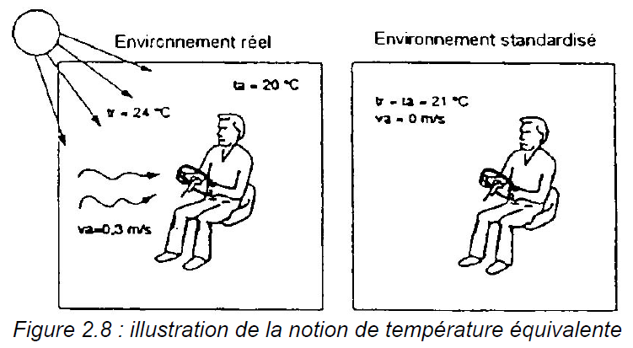
Railway HVAC digital twin – refrigerant compressors
Railway HVAC system modeled including:
Airflows between thermal zones
Tramway walls and windows
Relevant Variables
Compressor health indicator
Air ducts and air handling units
Passenger occupation and seats
Lecture 1: AI for Railway Transportation
Computation for Transportation Engineering – Hilary Term 2024

Slide 31
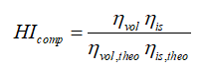
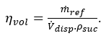
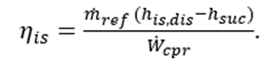
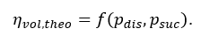
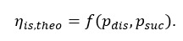
Compressor Health Indicator
Variable name | Description | Domain
T_{mix} | Mixed air temperature | Air side
W_{mix} | Mixed air humidity | Air side
T_{supply} | Supply air temperature | Air side
W_{supply} | Supply air humidity | Air side
V_{supply} | Supply air velocity | Air side
p_{dis} | Compressor discharge pressure | Refrigerant side
p_{suc} | Compressor suction pressure | Refrigerant side
T_{dis} | Compressor discharge temperature | Refrigerant side
T_{suc} | Compressor suction temperature | Refrigerant side
T_{evap,in} | Evaporator inlet temperature | Refrigerant side
T_{evap,out} | Evaporator outlet temperature | Refrigerant side
T_{cond,in} | Condenser inlet temperature | Refrigerant side
T_{cond,out} | Condenser outlet temperature | Refrigerant side
U | Compressor motor voltage | Electrical side
I | Compressor motor current | Electrical side
Relevant quantities are either measured directly or calculated using the digital twin.
Ageing effects
Lecture 1: AI for Railway Transportation
Computation for Transportation Engineering – Hilary Term 2024

Slide 32
Agenda
AI and Machine Learning: an overview
AI and Machine Learning for Railway Maintenance
Predictive Maintenance of Air Conditioning Subsystem
Monitoring of compressor performance: test bench and train results
Limitations, challenges and promises
Lecture 1: AI for Railway Transportation
Computation for Transportation Engineering – Hilary Term 2024

Slide 33
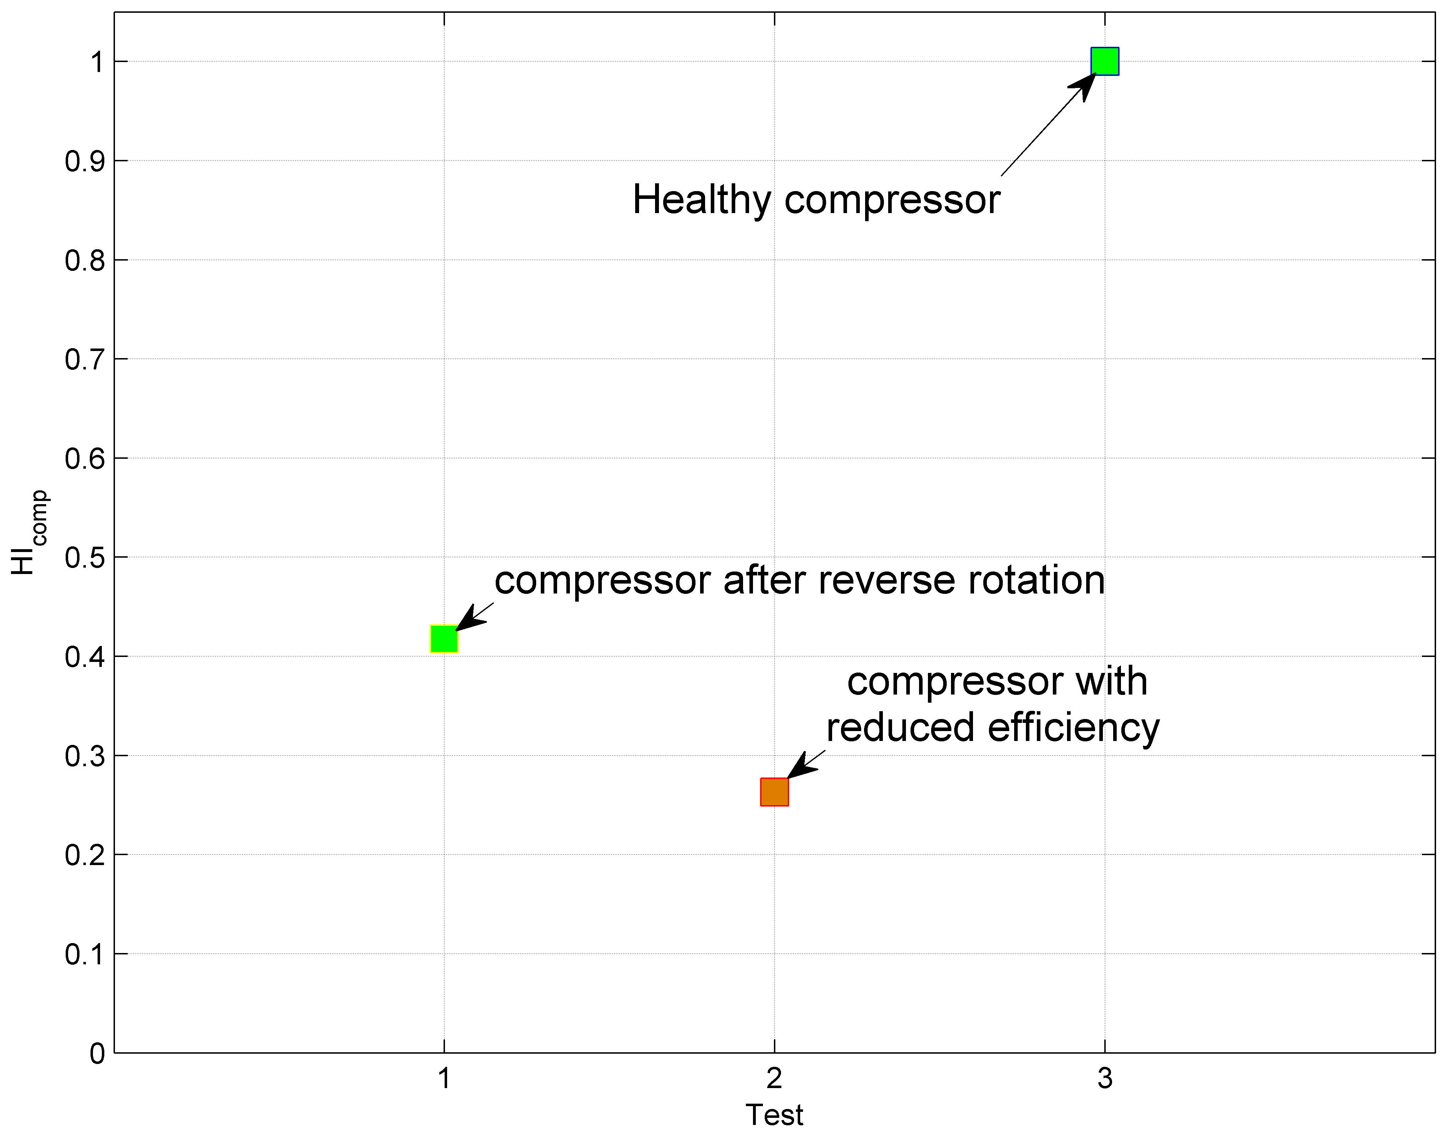
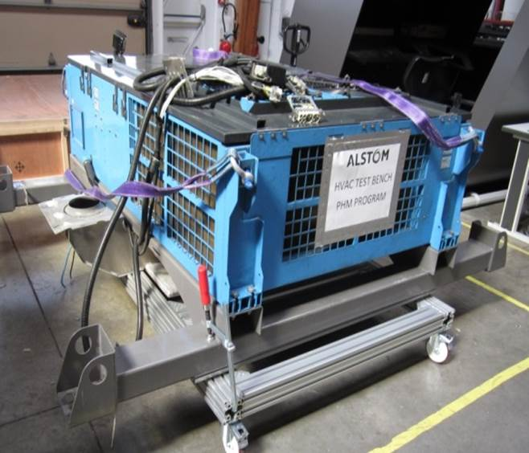
Test bench application
The health indicator exhibits a detectable reduction when degradations are introduced .
Lecture 1: AI for Railway Transportation
Computation for Transportation Engineering – Hilary Term 2024

Slide 34
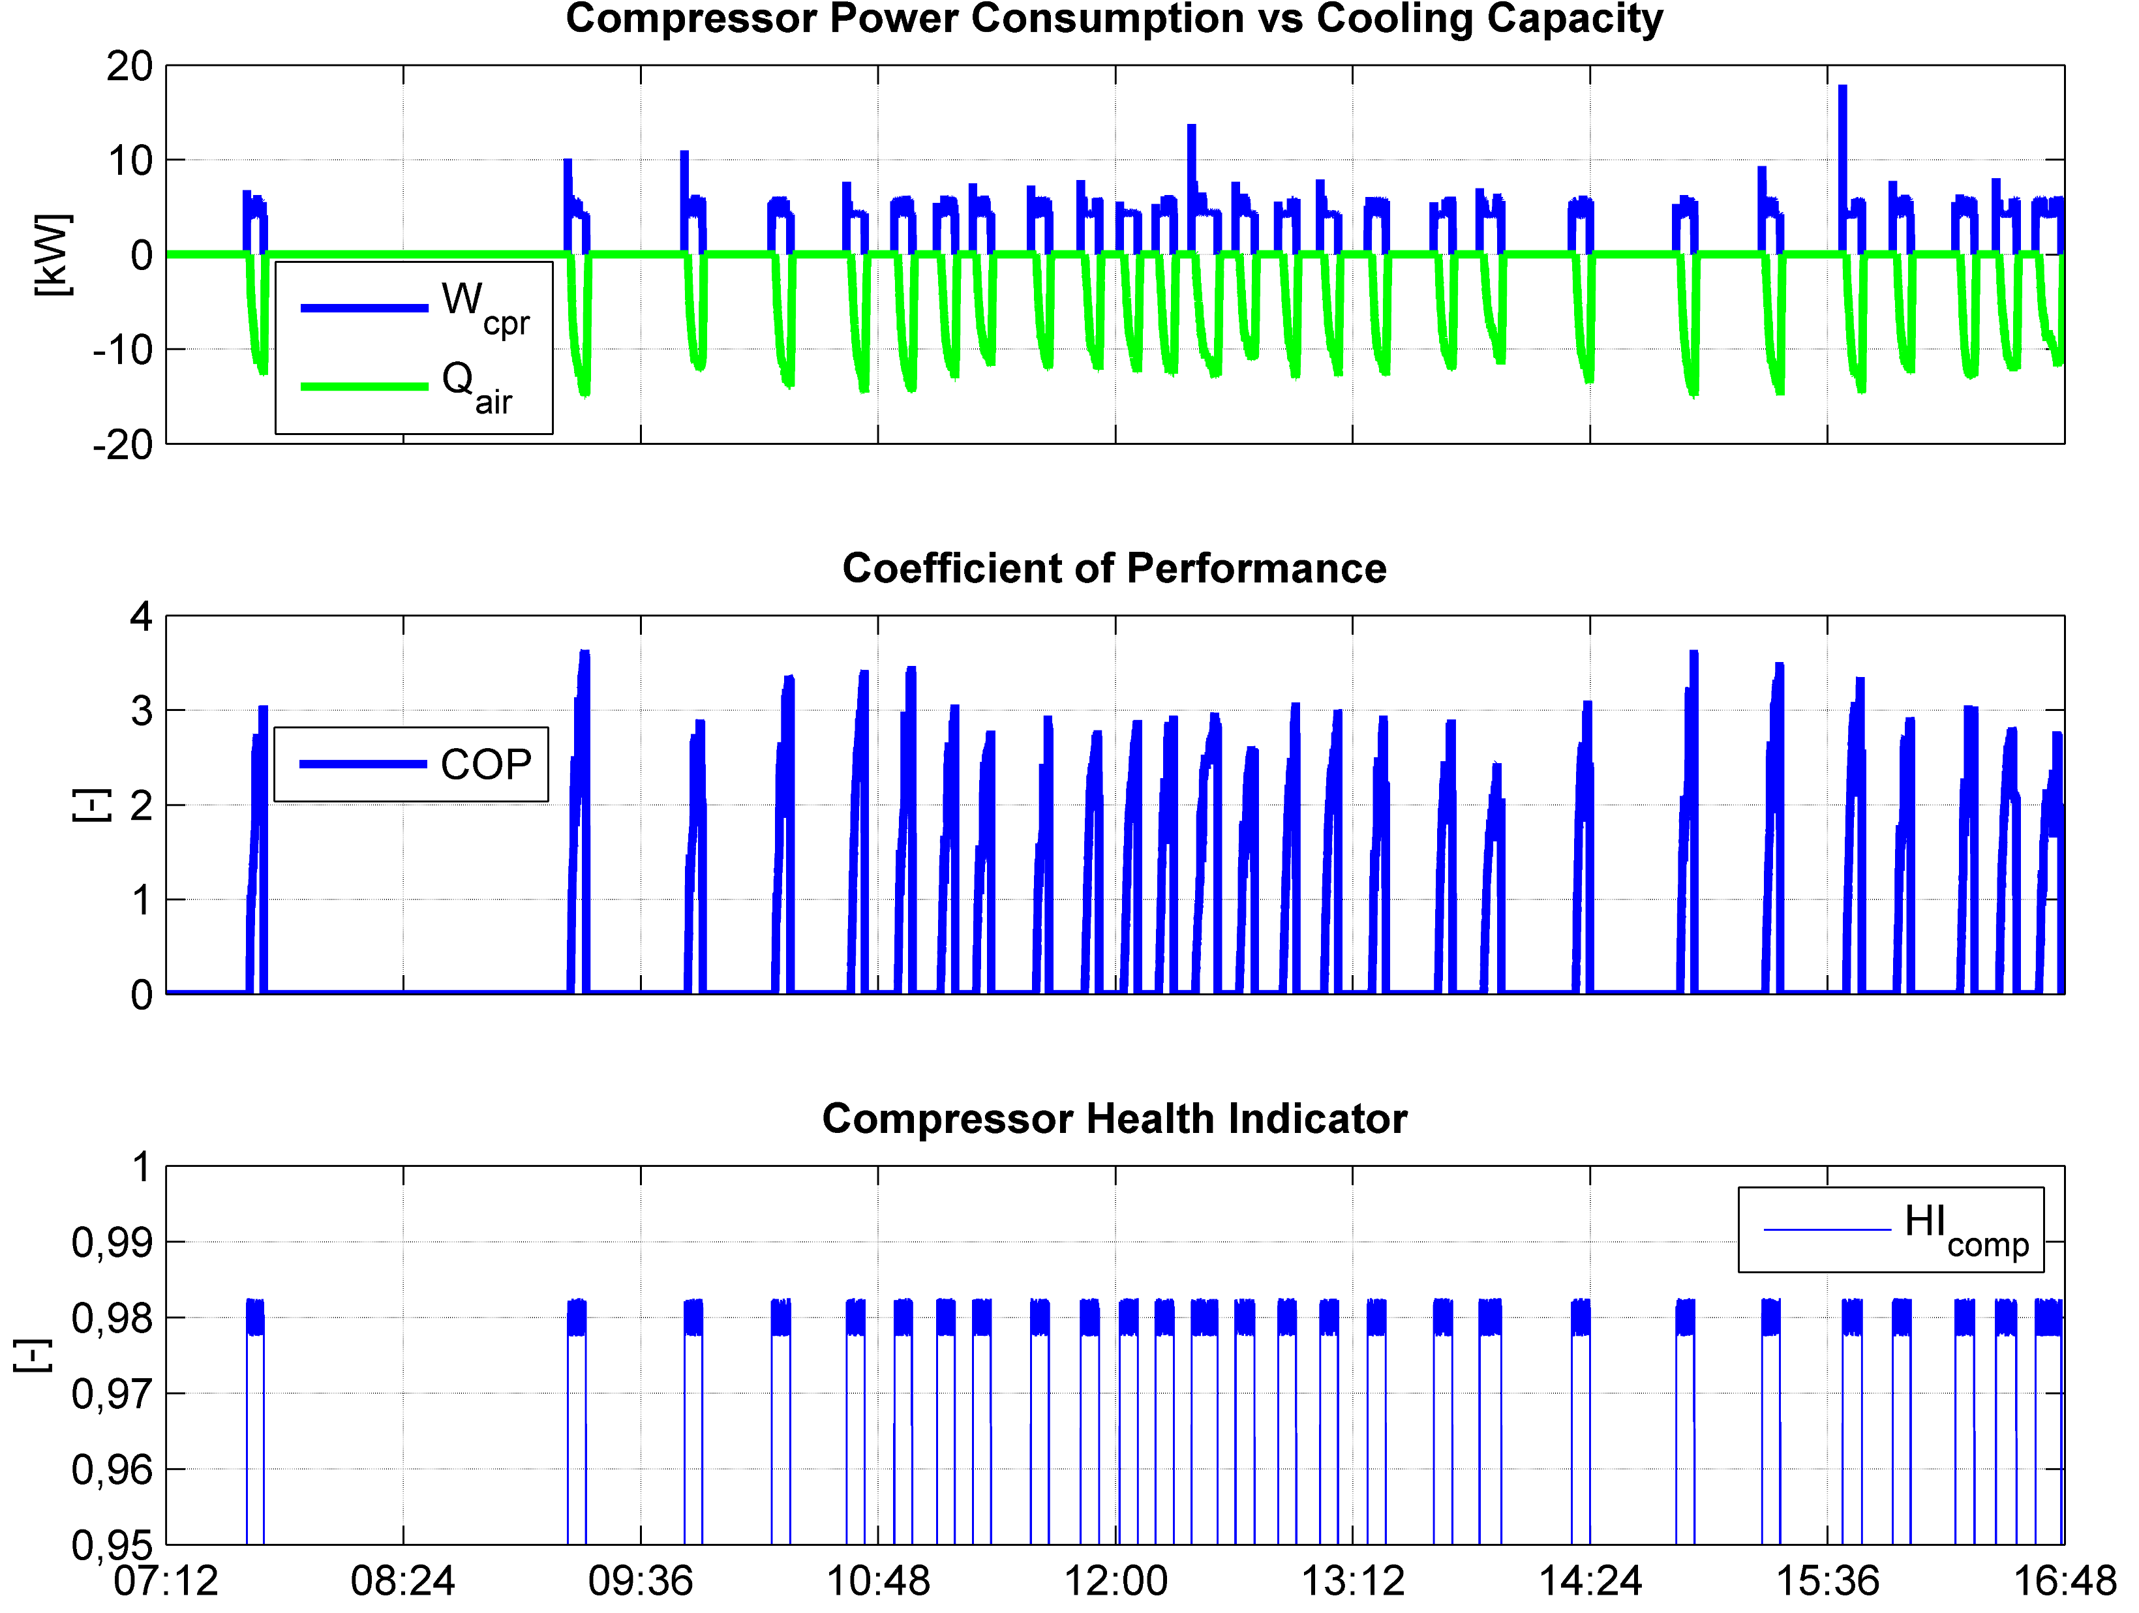
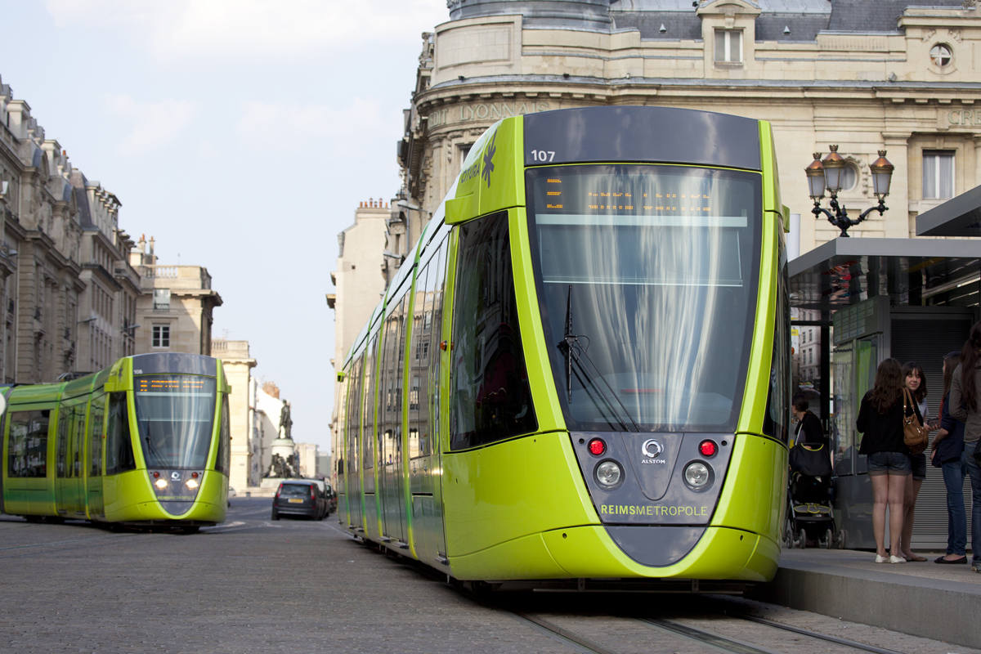
Field application
Large COP variations.
Precise indications from HI
Lecture 1: AI for Railway Transportation
Computation for Transportation Engineering – Hilary Term 2024

Slide 35
Agenda
AI and Machine Learning: an overview
AI and Machine Learning for Railway Maintenance
Predictive Maintenance of Air Conditioning Subsystem
Monitoring of compressor performance: test bench and train results
Limitations, challenges and promises
Lecture 1: AI for Railway Transportation
Computation for Transportation Engineering – Hilary Term 2024

Slide 36

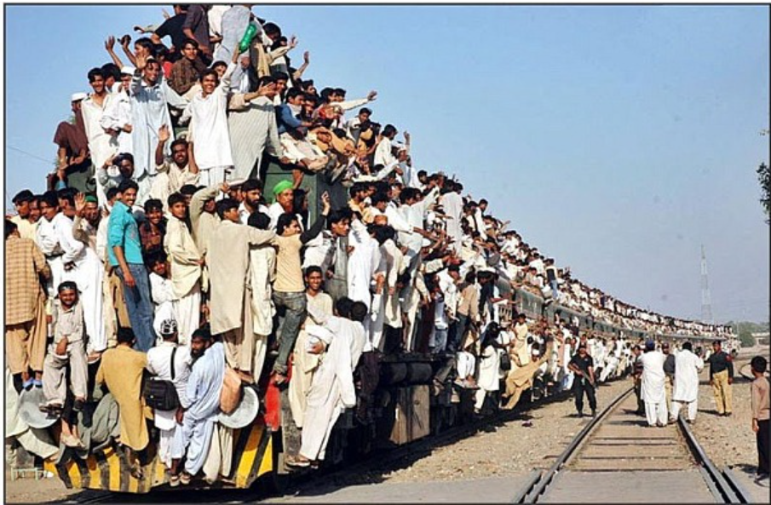
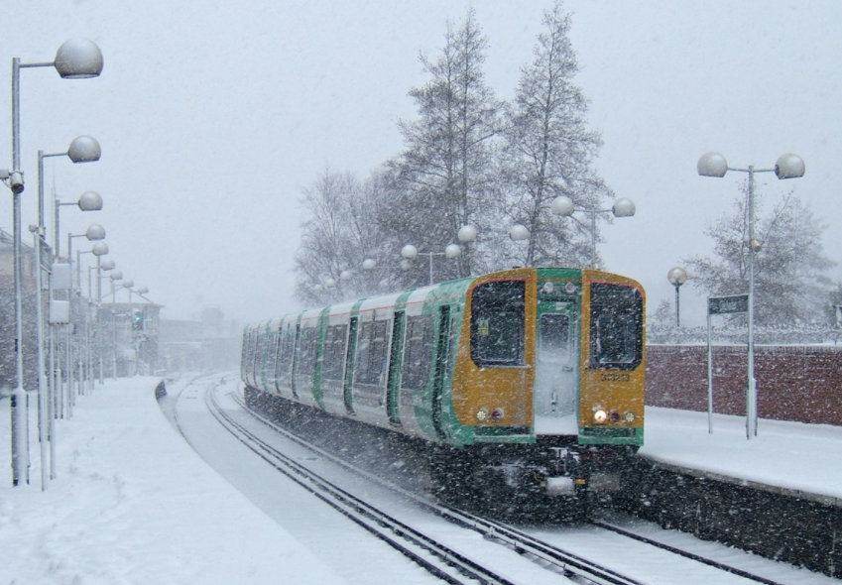
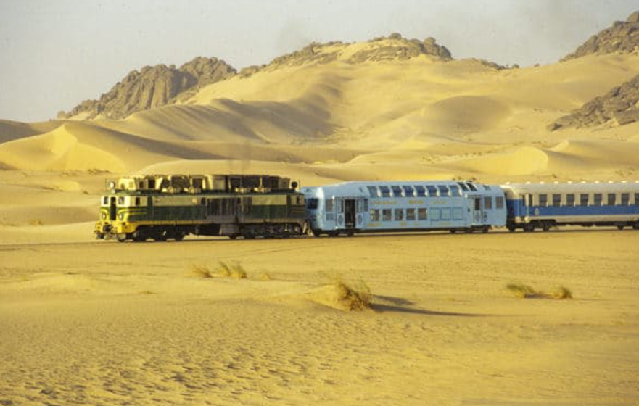
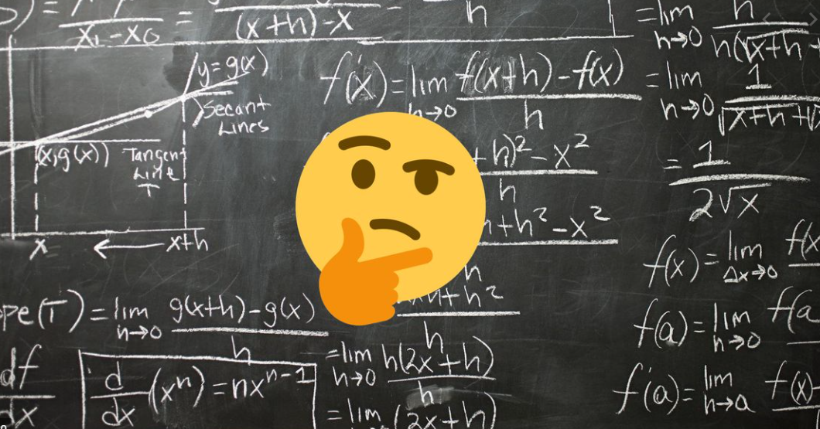

Technological challenges and limitations
Data
Access to field data
Rare events
Lack of labelled data
Unbalanced data
Statistical assumptions
Context factors
Domain knowledge
Physics of failure
Mission profiles
Performance
Algorithms KPI
Cybersecurity
Lecture 1: AI for Railway Transportation
Computation for Transportation Engineering – Hilary Term 2024

Slide 37
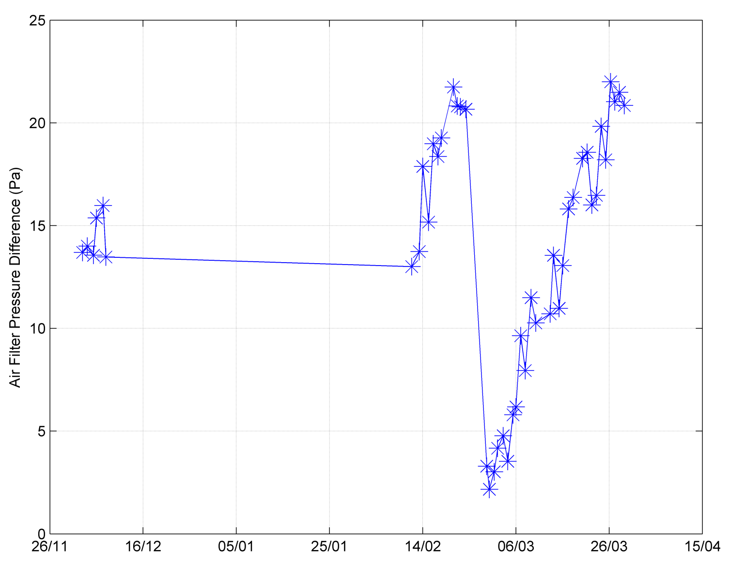
Technological challenges and limitations
Example: access to labelled data
Filter replaced?
Maintenance team in confirmed air filter had been replaced on 27/02 as revealed by data analysis.
if we did not know that maintenance has taken place, the health indicator would not be interpreted correctly
Unit not operated
Lecture 1: AI for Railway Transportation
Computation for Transportation Engineering – Hilary Term 2024

Slide 38
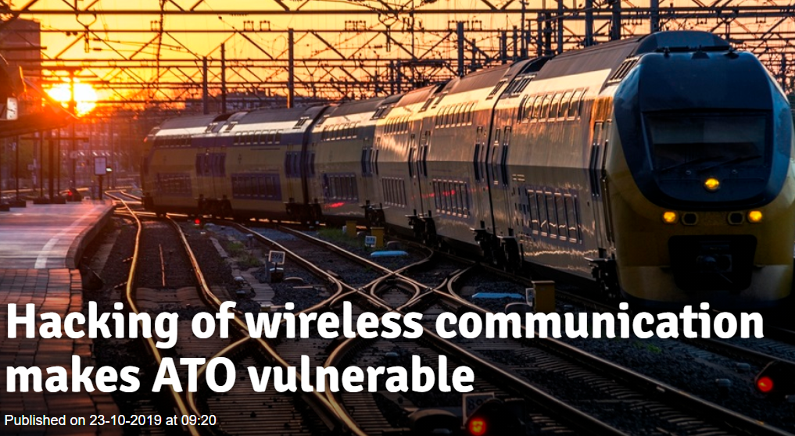
Technological challenges and limitations
Example: risk of cyber-attack
Lecture 1: AI for Railway Transportation
Computation for Transportation Engineering – Hilary Term 2024

Slide 39
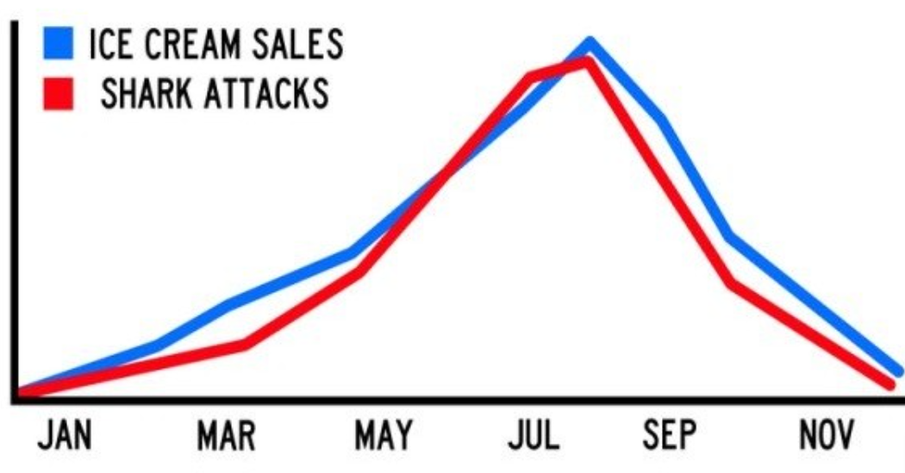
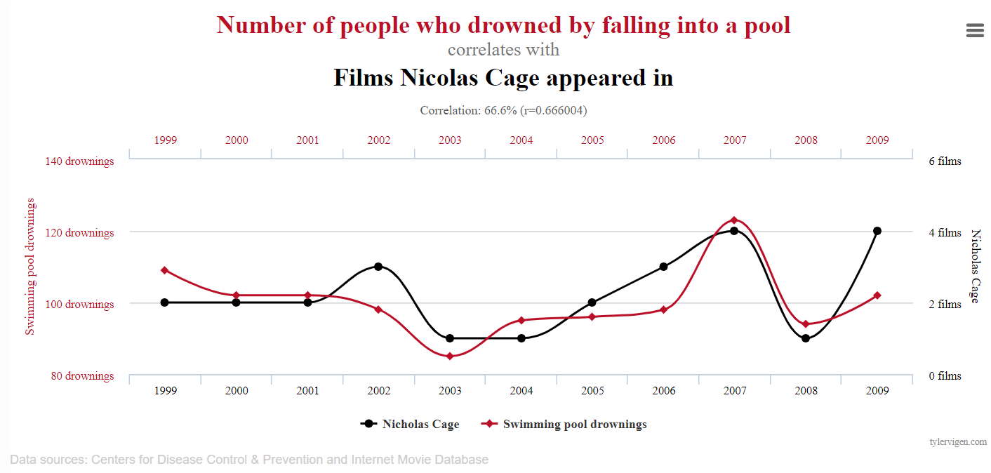
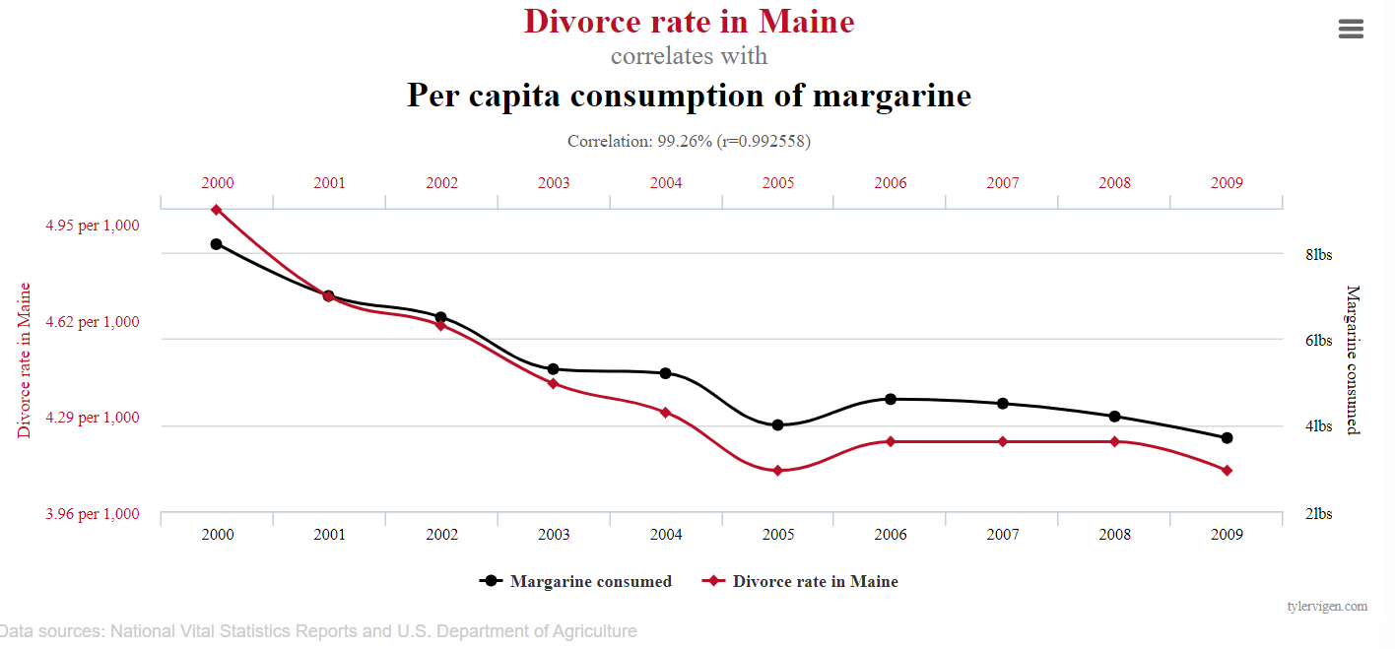
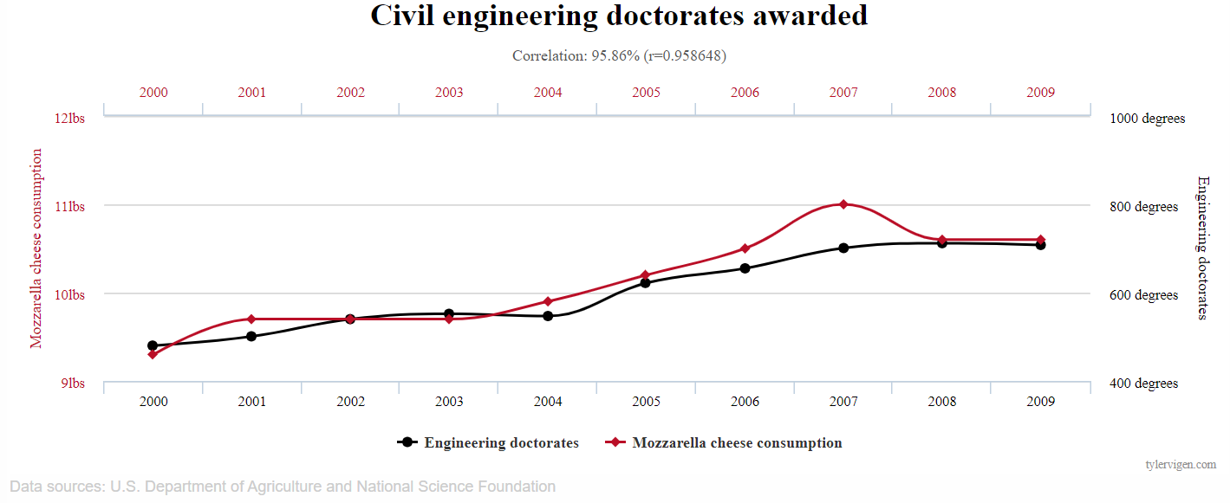
Correlation Does Not Imply Causation
At present, Machine Learning is good at finding correlations and patterns in data, but… are those always meaningful?
Larger dataset tend to contain increased number of spurious correlations.
spurious correlations
https://www.tylervigen.com/spurious-correlations
Lecture 1: AI for Railway Transportation
Computation for Transportation Engineering – Hilary Term 2024

Slide 40
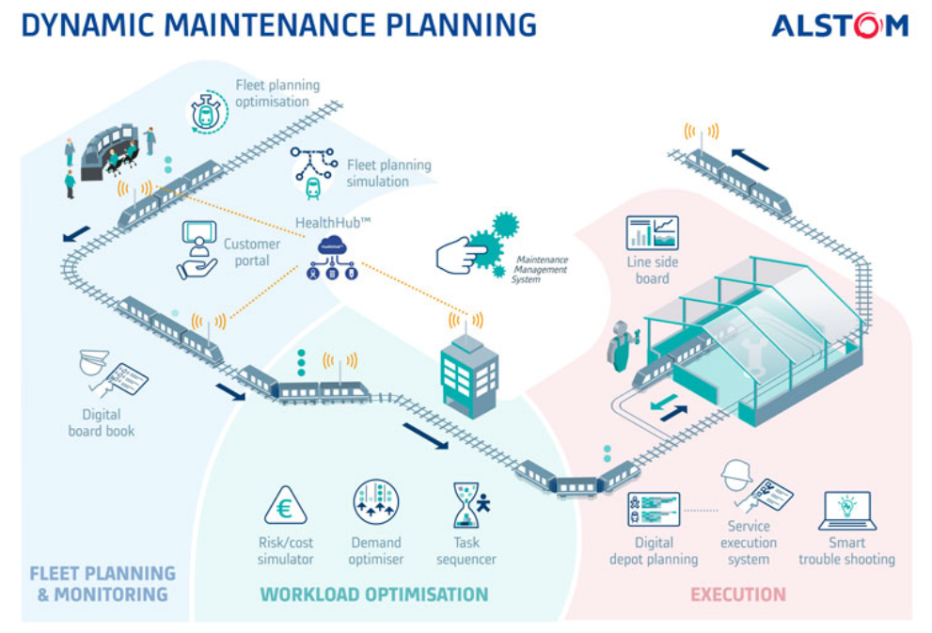
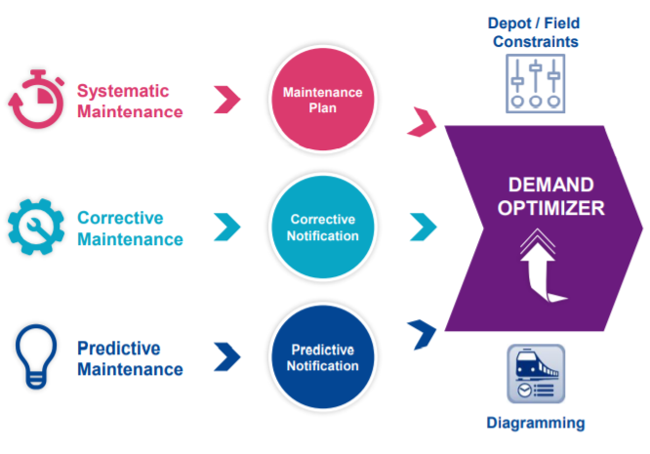
Promises: Dynamic Maintenance Planning
DMP: Optimizing with constraints
Lecture 1: AI for Railway Transportation
Computation for Transportation Engineering – Hilary Term 2024

Slide 41
Promises: long term vision
Combine data-driven and model-based approaches: the data and expert knowledge ( back to symbolic AI ?)
Expertise illuminates data
Data feeds expertise
Put AI in the control loop: toward autonomous systems ? → ethical aspects.
Toward a large shared data base of labelled data (analogous to what was done in computer vision: ImageNet) ?
Lecture 1: AI for Railway Transportation
Computation for Transportation Engineering – Hilary Term 2024

Slide 42
Some considerations
Artificial Intelligence is best where the human is weakest:
handling many variables simultaneously ( ‘ big data’)
making simple decisions quickly about complex systems
finding patterns among apparent chaos
repetitive tasks
Artificial intelligence is ( and probably will long remain ) weak where human is strong:
true generalization capability ( avoiding overfitting) from small data
domain expertise
Human + IA : a sustainable partnership. Experts will be able to concentrate on their expertise and exercise their critical minds rather than handling computer files.
Lecture 1: AI for Railway Transportation
Computation for Transportation Engineering – Hilary Term 2024

Slide 43
Agenda
AI and Machine Learning: an overview
AI and Machine Learning for Railway Maintenance
Predictive Maintenance of Air Conditioning Subsystem
Monitoring of compressor performance: test bench and train results
Limitations, challenges and promises
Key Takeaways
Lecture 1: AI for Railway Transportation
Computation for Transportation Engineering – Hilary Term 2024

Slide 44
Key takeaways
Although relative recent, computer-based AI has gone through alternate fortunes over the (e.g. AI winters), with different approaches (e.g. manipulation of symbols, connectionisms).
Machine Learning: instead of coding a procedure, learn from the data
Supervised
Unsupervised
Reinforcement learning
Railway maintenance: corrective, preventive, predictive
Main goals: reliability, availability, savings
Prognostics and Health Management:
State detection, diagnostics, prognostics
Evaluation metrics: confusion matrix (binary, multiclass)
Promises and challenges:
Limitations from: data, technology, human
Correlation does not imply causation
Promises: AI+Human partnership
Lecture 1: AI for Railway Transportation
Computation for Transportation Engineering – Hilary Term 2024

